Slide 1
ECE532 - Project Presentation
Raiden - a scrolling shooter game
Prepared By: Sheng Zhan
Yi Tian Lu
Zhe Wu

Slide 2
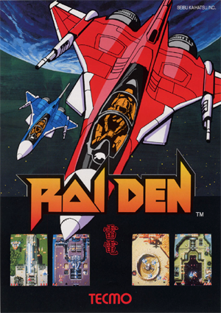
What is Raiden
Our team decides to develop and reproduce one of the classical scrolling shooter game, Raiden, on the Xilinx Nexys4 DDR FPGA Board, with real-time motion detection as the controllers.
Japanese arcade flyer of Raiden

Slide 3
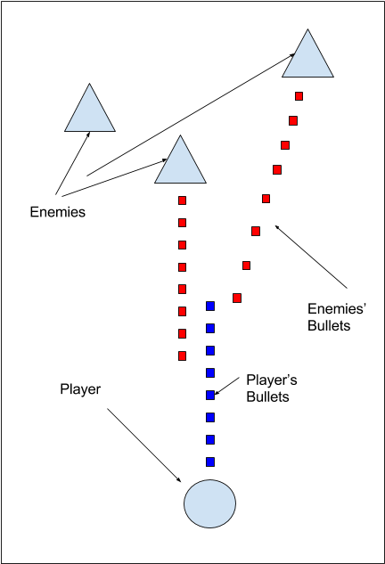
What we planned
Functional requirements and Features
Player aircraft is controlled by real-time motion
Enemies spawn and move randomly
Player aircrafts and enemy aircrafts are eliminated by collision with each others’ bullets
Player will gain scores when the enemy aircraft is eliminated
Mission fails when the player’s aircraft is hit by the enemy
Background music is played when game starts
The speed and quantity of the enemy unit can vary with difficulty levels
The background of the video output will be scrolling.

Slide 4
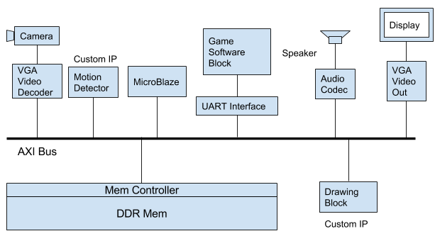
What we planned

Slide 5
What difficulties we had
Detector IP:
Camera was not working properly initially
Require lots of debugging on real time input
Software:
No proper memory management

Slide 6
What difficulties we had
Graphics IP:
Took some time to understand AXI Full Master interface
Needed to look at existing IP(BRAM, FIFO, etc.) interface and debug with them
Performance was a concern

Slide 7
What difficulties we had
Audio IP
Simulation result cannot represent the sound signal very well (Since the freq of the sound is much lower than the clk frequency, need to increase the sound output freq to simulate)
Checking the quality of a sound effect usually need to synthesis the design and load to the board, which is very time consuming
Difficulties on implementing Pulse Density Modulation(PDM) to create each sound notes

Slide 8
What we have achieved
Functional requirements and Features
Player aircraft is controlled by real-time motion (Done)
Enemies spawn and move randomly (Done)
Player aircrafts and enemy aircrafts are eliminated by collision with each others’ bullets (Done)
Player will gain scores when the enemy aircraft is eliminated (Done)
Mission fails when the player’s aircraft is hit by the enemy (Done)
Background music is played when game starts (Done)
The speed and quantity of the enemy unit can vary with difficulty levels (Done)
The background of the video output will be scrolling (Done)
Two players can play at the same time (Extra)
Sound effects are generated when enemies is eliminated (Extra)

Slide 9
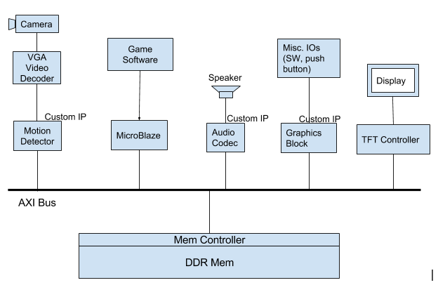
Final Block Diagram

Slide 10
Custom IPs
Graphics Block
- slave side receives drawing request
- master side reads images from BRAMs
- and writes image data or color blocks to DDR memory for display
Motion Detector Block
- read from camera images
- detects two color blocks
- saves detected position to registers
Audio Block
- plays background music or sound effects upon request
- multiplexes sound effect and background music

Slide 11
Borrowed IPs
OV7670
TFT Controller
Microblaze
AXI Interconnect
DDR Memory Controller
Misc. (FIFOs, BRAMs)

Slide 12
How we managed the project
Make detailed plans every week
Make sure each individual task can be tested/verified
Assign specific tasks to each team member

Slide 13
What we have learned
Technical skills
Communication and Teamwork
Time management

Slide 14
Thank You!
Demo Time

